Slide 1

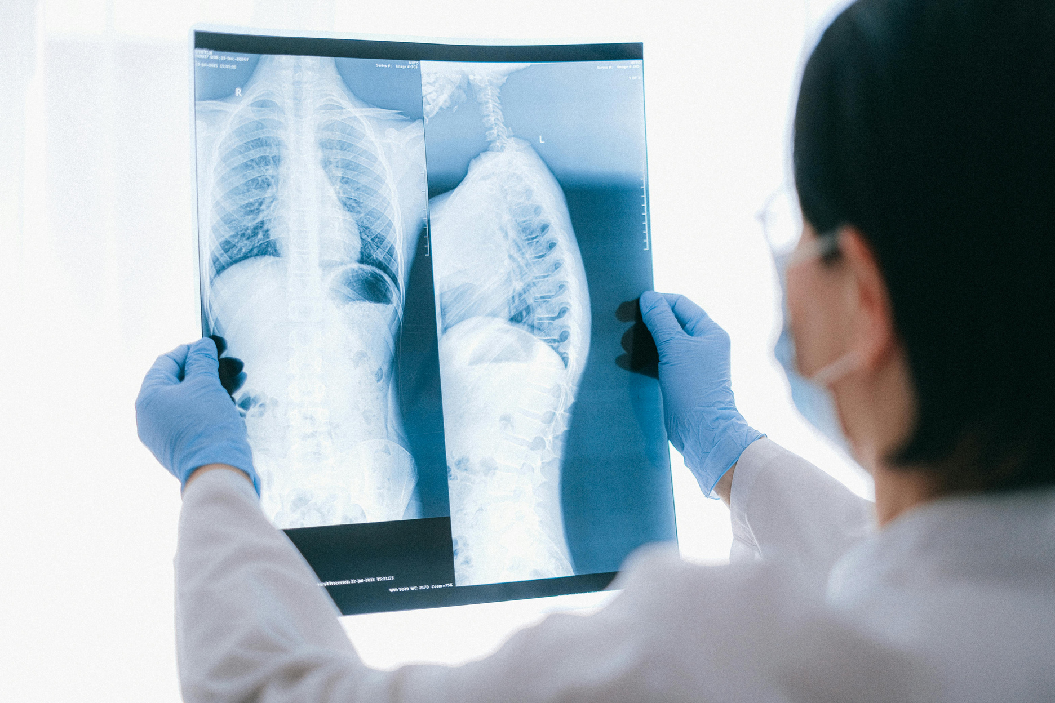
Medical Image Analysis
Capstone 3 Project for Data Science Audience
Presented by
Sona Guliyeva
Under the mentorship: Ricardo Alanis

Slide 2


Challenges in Healthcare
Pneumonia detection remains time-consuming and often inaccurate.
High rates of misdiagnosis can lead to severe health consequences.
An automated solution can enhance efficiency and accuracy.
Leveraging technology to improve patient outcomes is crucial.

Slide 3

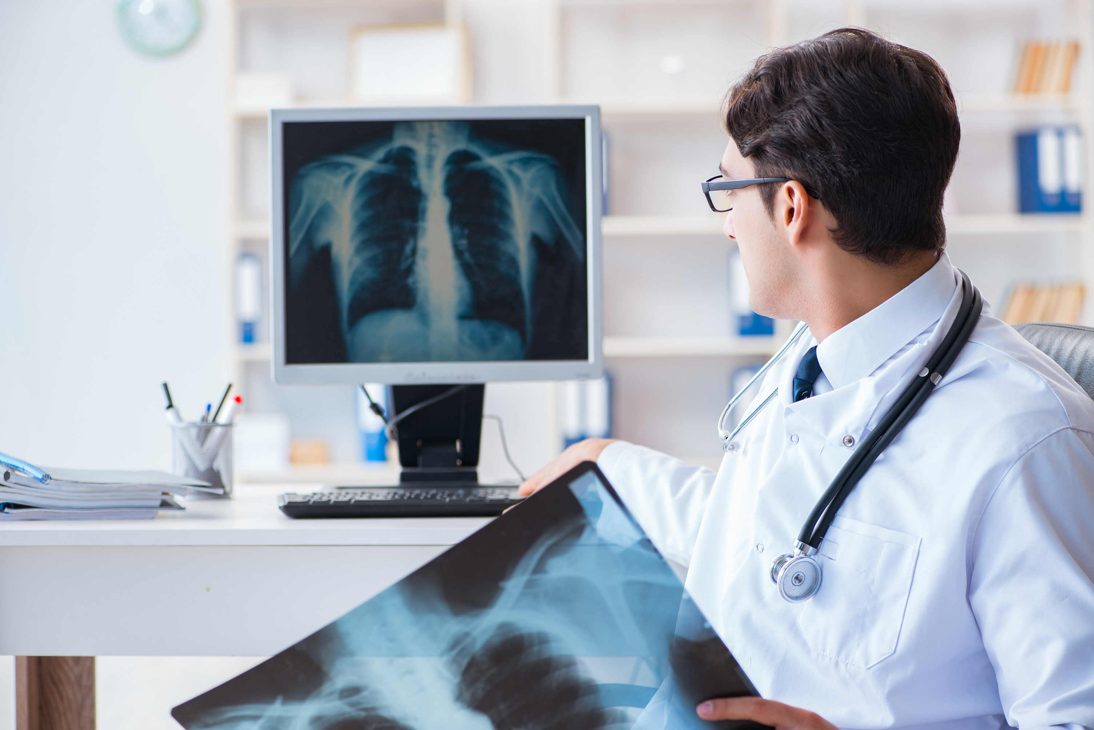
Project Objectives
Automated Detection Goals
Success Metrics
Stakeholder Engagement
Success will be measured by evaluating the accuracy, precision, and recall of the model against established benchmarks, ensuring that it meets or exceeds the required standards for clinical application and patient safety.
The primary goal is to develop an automated pneumonia detection system that can accurately analyze medical images, improving diagnosis speed and ensuring timely treatment for patients, enhancing overall healthcare efficiency.
Engaging stakeholders such as healthcare professionals and data scientists is crucial to align objectives with real-world needs, ensuring the project is viable, effective, and beneficial for patient outcomes in pneumonia detection.

Slide 4
Scope and Constraints
Project Limitations
Data Availability
Regulatory Compliance
The project faces resource limitations including time and funding, which restrict the extent of data collection and model training. Addressing these constraints is crucial for achieving a meaningful outcome in pneumonia detection.
The success of the project hinges on access to high-quality labeled datasets. Limited availability of comprehensive medical images can impact the effectiveness of the models developed for pneumonia detection.
Navigating through healthcare regulations is essential. Compliance with data privacy laws and ethical standards is paramount to ensure the project aligns with best practices in medical data usage.

Slide 5
Key Data Sources
Data Collection Methods
Stakeholder Engagement
Ethical Considerations
We uphold strict ethical standards in data handling, ensuring patient privacy and compliance with regulations. Transparency with stakeholders is fundamental to maintain trust and accountability throughout the project's lifecycle.
To ensure accuracy, we sourced medical images from public databases and partnered with local hospitals to gather real-world data for pneumonia detection, enriching our dataset for better training and validation.
Engaging with healthcare professionals and data scientists is crucial. Their insights help us align our project goals with industry needs, ensuring relevant outcomes and practical applications in real-world healthcare scenarios.

Slide 6

Methodology Overview
Data Collection Process
Image Preprocessing Techniques
Model Development Strategy
The initial phase involves gathering a diverse dataset of medical images. This collection is crucial for training the model accurately to detect pneumonia effectively.
Images undergo various preprocessing steps such as normalization and augmentation. These techniques enhance model performance by providing a robust dataset that improves generalizability.
After preprocessing, we implement a structured approach for model development, selecting algorithms based on performance metrics to ensure accurate pneumonia detection.

Slide 7

Data Wrangling Timeline
Data Collection
Gathered diverse medical images for analysis.
Data Cleaning
Removed inconsistencies and irrelevant data points.
This timeline outlines key milestones in the data wrangling process for the project.
Data Transformation
Applied necessary transformations for model readiness.
Data Integration
Integrated datasets into a unified format for analysis.

Slide 8

EDA: Initial Insights
Summary Statistics
Visual Trends
Insights Gained
The dataset reveals a notable imbalance between pneumonia and non-pneumonia cases, highlighting the need for effective techniques to ensure accurate detection and minimize potential misclassifications during model training.
Initial visualizations indicate that certain patterns emerge in the images, suggesting correlations between specific characteristics and pneumonia presence, prompting deeper exploration into their significance for detection accuracy.
Through this exploratory analysis, we identify key features that may enhance our model's performance, providing a strong foundation to refine our approach for automated pneumonia detection in medical imaging.

Slide 9

Visualizing Image Characteristics
Importance of Image Quality
Image Diversity Matters
Feature Extraction Techniques
The quality of medical images is critical for accurate pneumonia detection. High-resolution images provide essential details, allowing for better analysis and improving the overall reliability of the automated detection system.
A diverse dataset with various image types enhances the robustness of our model. By including images with different conditions and characteristics, we ensure that the model generalizes well across different patient scenarios.
Implementing effective feature extraction techniques is vital for identifying key attributes in medical images. These techniques help the model distinguish between healthy and infected lung patterns, improving diagnostic accuracy.

Slide 10
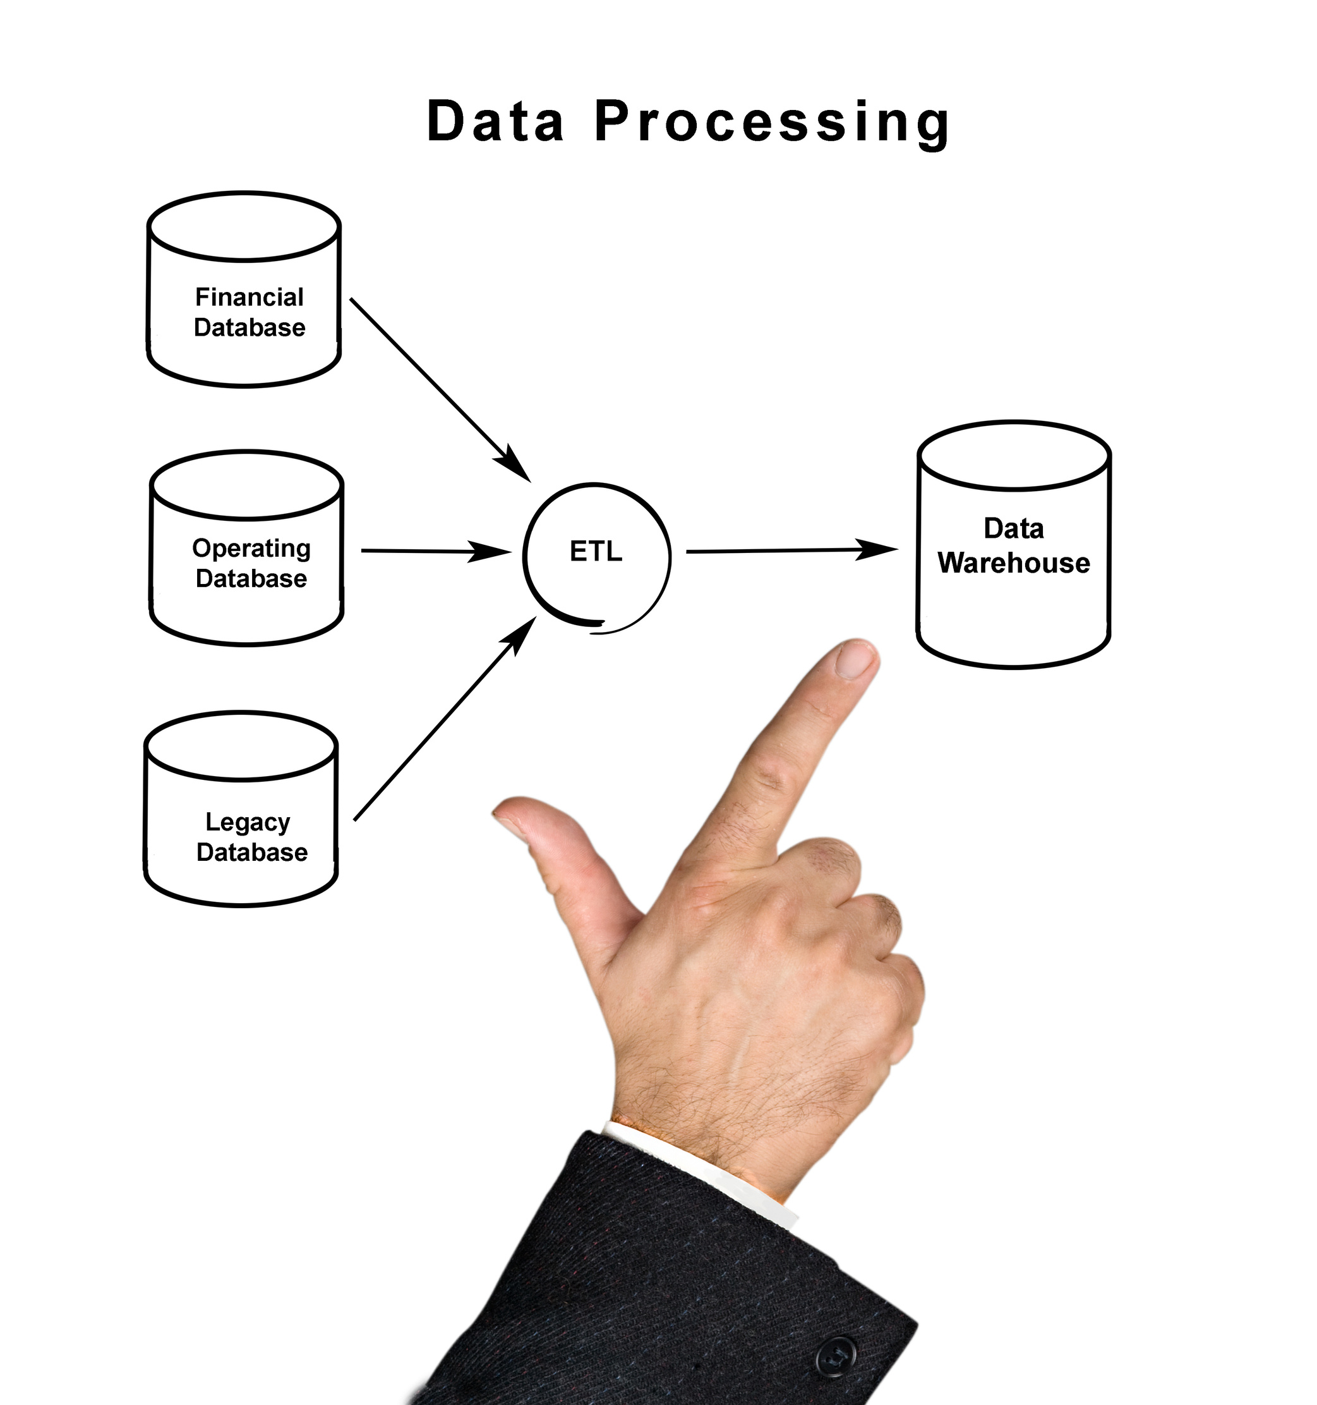
Pre-processing & Training Data
Data Preparation Steps
Augmentation Techniques
Training Data Development
Effective pre-processing is essential for training machine learning models. This involves data cleaning, normalization, and augmentation to ensure the dataset is well-structured and suitable for model training.
To enhance model accuracy, we employ various augmentation techniques such as rotation, scaling, and flipping. These techniques help to artificially expand the dataset and improve model robustness against variations.
The development of training data includes splitting the dataset into training, validation, and test sets, ensuring that the model can generalize well to unseen data while avoiding overfitting.

Slide 11

Model Architecture
Selecting the Right Model
Neural Network Benefits
Evaluation of Models
Utilizing a neural network offers significant advantages, such as enhanced feature extraction and improved performance on complex datasets. These models can learn intricate patterns in the data, leading to better detection rates.
Rigorous evaluation is essential to ensure the model's performance meets our objectives. By comparing various architectures, we can determine the most effective approach for accurate pneumonia detection.
Choosing an appropriate architecture is crucial for effective pneumonia detection. Different models provide varying levels of accuracy and efficiency in identifying pneumonia in medical images.

Slide 12

Compilation & Training Setup
Model Compilation Process
Training Data Preparation
Training Configuration
The model compilation involves setting the optimizer, loss function, and metrics to evaluate during training. Choosing the right optimizer is crucial for efficient convergence towards a well-performing model.
Preparing the training data includes splitting datasets into training, validation, and test sets. This ensures that the model generalizes well, minimizing overfitting and providing accurate evaluations on unseen data.
The training configuration covers batch size, epochs, and learning rates. These parameters significantly impact the training efficiency, affecting both the speed and quality of the model's learning process.

Slide 13

Model Evaluation Metrics
Key Performance Indicators
Confusion Matrix Insights
ROC Curve Analysis
Analyzing the ROC curve allows us to evaluate the trade-off between sensitivity and specificity. The area under the curve (AUC) quantifies the model's ability to distinguish between classes, indicating overall performance.
Understanding the key performance indicators is crucial for assessing our model's effectiveness. Metrics like accuracy, precision, and recall all play vital roles in ensuring reliable pneumonia detection.
The confusion matrix provides a visual representation of our model's performance. It illustrates true positives, false positives, true negatives, and false negatives, essential for understanding classification accuracy and error types.

Slide 14

Model Evaluation Metrics
Classification Report Overview
Confusion Matrix Analysis
Performance Insights
Analyzing these metrics allows us to gauge the model's effectiveness in real-world scenarios, ensuring that patients receive timely diagnoses. Continuous evaluation is essential for maintaining high accuracy and reliability in pneumonia detection.
The classification report provides a comprehensive summary of the model's performance, detailing precision, recall, F1-score, and support for each class. This information is crucial for understanding the model's ability to identify pneumonia accurately.
A confusion matrix visually represents the performance of the model by displaying true versus predicted classifications. It helps identify areas where the model excels and where it may struggle, guiding further improvements.

Slide 15

Model Evaluation
Understanding ROC Curve
Interpreting AUC Value
Importance of Evaluation
The AUC (Area Under the Curve) quantifies model performance. An AUC value of 1.0 represents perfect accuracy, while a value of 0.5 indicates no discriminative ability. Our model's AUC reflects its effectiveness in pneumonia detection.
The ROC Curve illustrates the trade-off between sensitivity and specificity, highlighting how well our model distinguishes between pneumonia and non-pneumonia images. A curve closer to the top left indicates better model performance.
Robust evaluation of our model using ROC and AUC is crucial for understanding its real-world applicability. This ensures that our automated system can effectively assist in early pneumonia detection, enhancing healthcare outcomes.

Slide 16
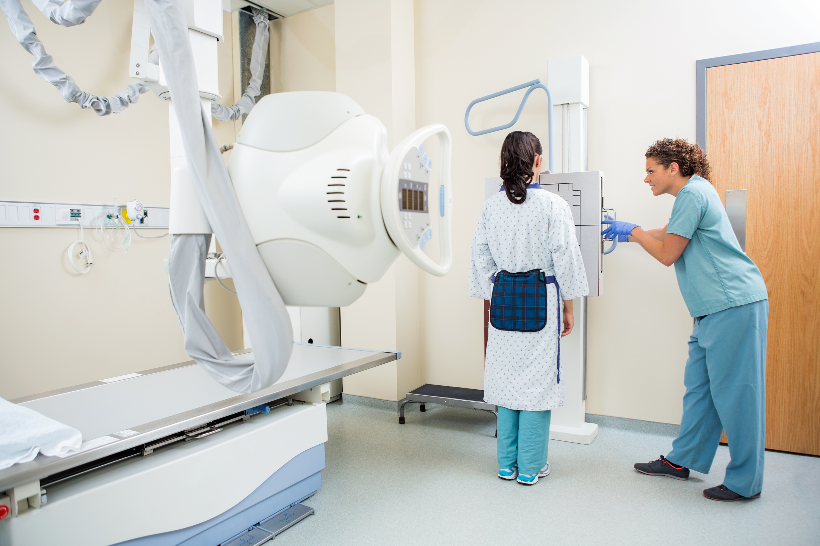
Assessment & Future Work
Focus on enhancing automated pneumonia detection accuracy.
Explore new algorithms for better performance.
Collaborate with healthcare providers for real-world applications.
Conduct further studies on data diversity and model robustness.

Slide 17
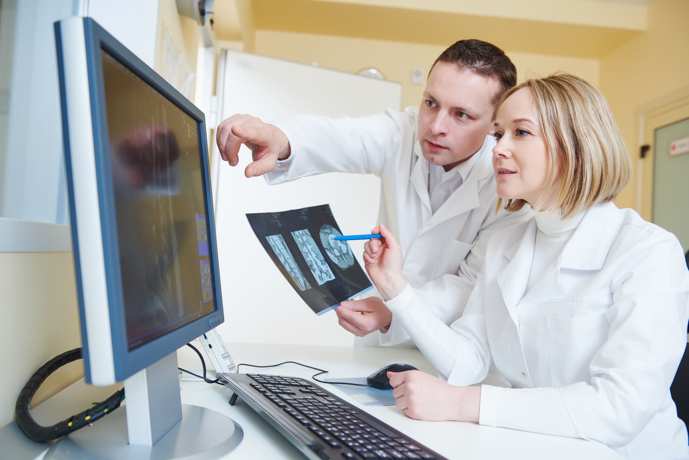
Conclusion & Summary
Automated pneumonia detection improves healthcare efficiency.
The project utilizes cutting-edge image analysis techniques.
Key stakeholders include healthcare professionals and data scientists.
Future work will focus on enhancing model accuracy and real-world application.

Slide 18
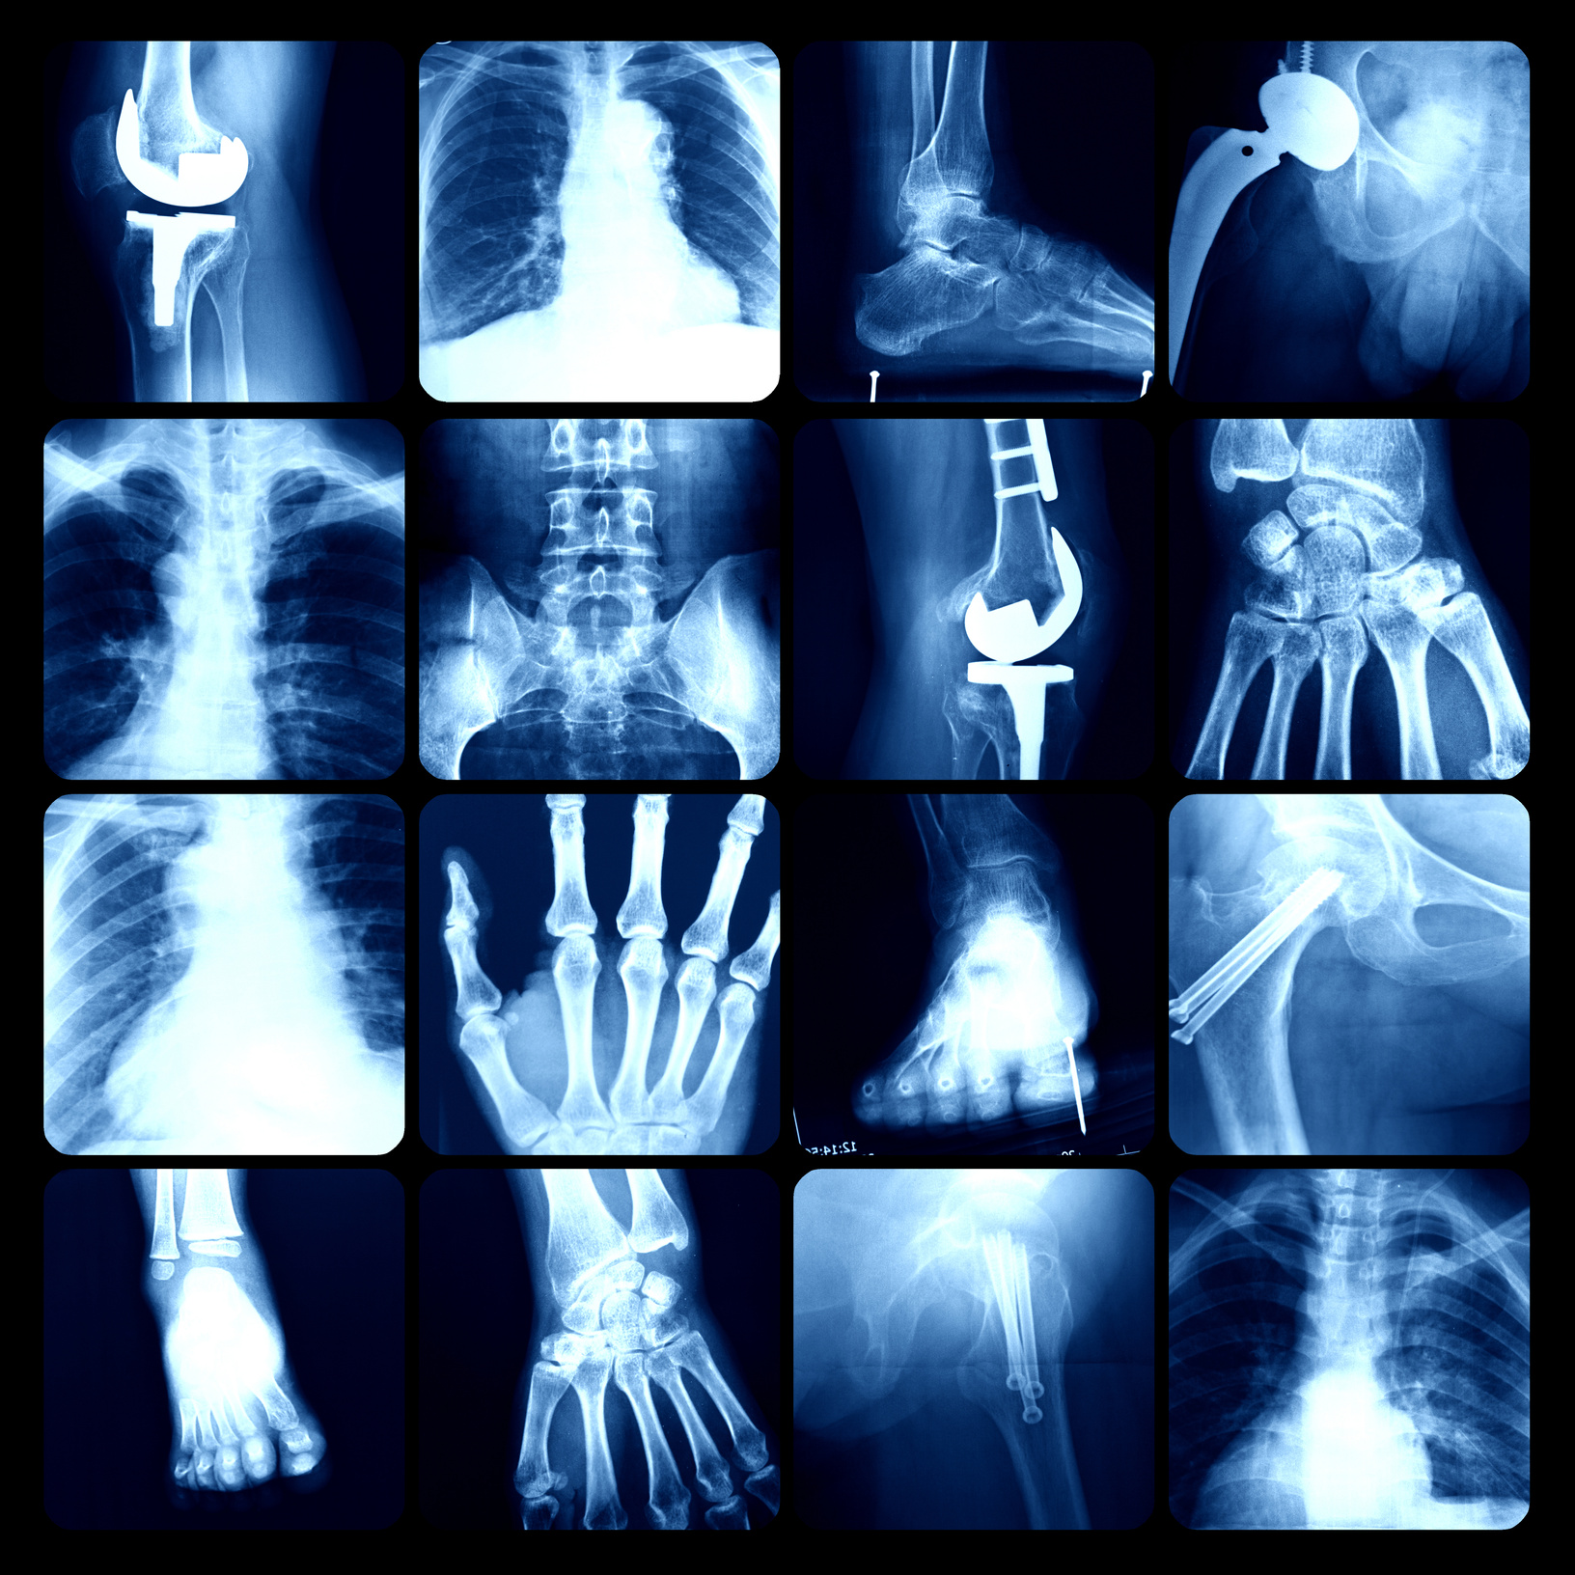
References & Resources
Comprehensive analysis of medical images for pneumonia detection.
Highlighting the need for automation in healthcare.
Utilizing data-driven methods to improve accuracy.
Collaboration with key stakeholders throughout the project.

Slide 19
Summary of Key Points
Automated pneumonia detection enhances healthcare efficiency.
The project aims to reduce diagnostic errors and increase accuracy.
Key stakeholders include healthcare providers and data scientists.
Future work will focus on improving model performance and expanding applications.
Thank you!

